Slide 1

Sprocket Central Pty Ltd
Data analytics approach

Slide 2
Agenda
Introduction
Data Exploration
Model Development
Interpretation

Slide 3
Introduction
Identify and recommend top level customers to target from the datasets
Contents of Data Analysis
Age category distributions.
No. of cars owned by different wealth segments in three different states.
Total number of people related with each job industry category.
Sum of the past 3 years bike purchases by gender in different job industry category
Outline of Problem
Sprocket central is a company that specializes in high-quality bikes and cycling accessories.
Their marketing team is looking to boost business sales by analysing provided datasets.
The aim is to analyse and recommend which of the 1000 customers that Sprocket Central should target to drive higher value to the company.

Slide 4
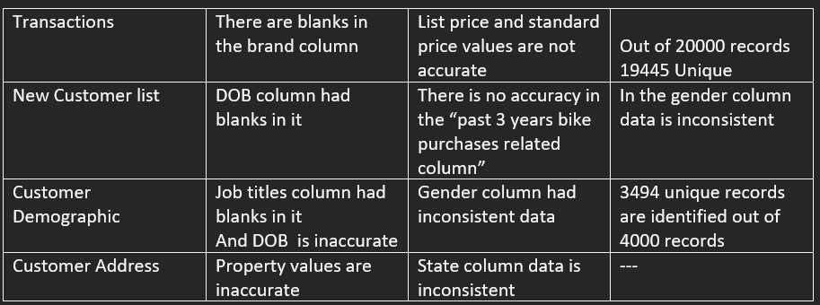
Data Exploration
Data Quality Assessment
Key Issues for Data Quality Assessment
Accuracy: Correct Values
Completeness: Data Fields with values
Consistency: Values free from contradiction
Currency: Values up to date
Relevancy: Data items with value meta-data
Validity: Data containing allowable values
Uniqueness: Records that are duplicated
Place any supporting images, graphs, data or extra text here.

Slide 5
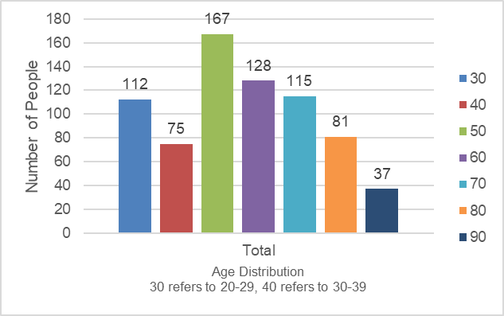
Data Exploration
New and Old Customer Age Distribution Analysis
New Customer Age Distribution
From the New Customer Age Distribution it is observed that highest amount of people fall under 50 i.e between 40-49.
And the second highest group belongs to age group of 50-59
Speaking of Old Customer Age Distribution Analysis , the highest number of people fall under 50 i.e from 40-49.
Where as the second most population is seen in the age group of 50-59.
It is interesting to note that the highest and second highest number of people in both the Age Distributions is found under the same age category.
Old Customer Age Distribution

Slide 6
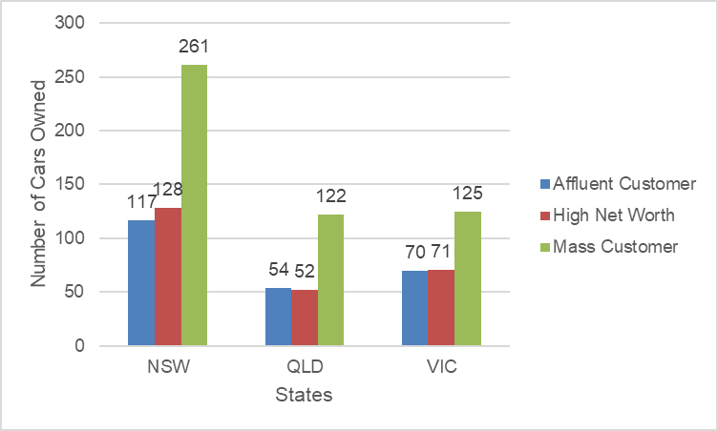
Data Exploration
Number of Cars owned by the respective Wealth Segments in Three different states
The fig. shows the Analysis of the number of cars owned by people belonging to different wealth segments in the states of NSW,QLD and VIC.
NSW (New South Wales) records the highest number of cars owned in the mass customer wealth segment.
And the cars owned by the Affluent Customer and High Net Worth segments in the state of QLD are comparatively less to that of the NSW and VIC.

Slide 7
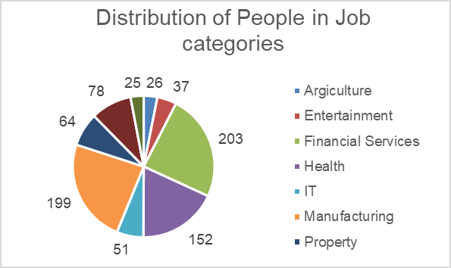
Data Exploration
The Pie chart shows the information of the amount of people in their respective job category.
The analysis is done by taking both males and females into consideration.
It is found that Financial Services category has the most number of people working in it.
It is Followed by Manufacturing and Health with 199 and 152 people.
And the least number of people are seen in Property job category.

Slide 8
Data Exploration
The fig. shows the analysis related to the sum of the past 3 years bike related purchases by people belonging to different Job Industry Category.
Financial Services tops the list with 10564 purchases.
Telecommunications indicates the least number of purchases with 1250.

Slide 9
Model Development
Customer Classification
With reference to the data exploration, the following are the clients to target from the data provided
Working with Financial services, Manufacturing , Health.
In the age group of 40-49.
Belonging to the states of New South Wales and Victoria.
Predominantly Mass Customer wealth segment.

Slide 10
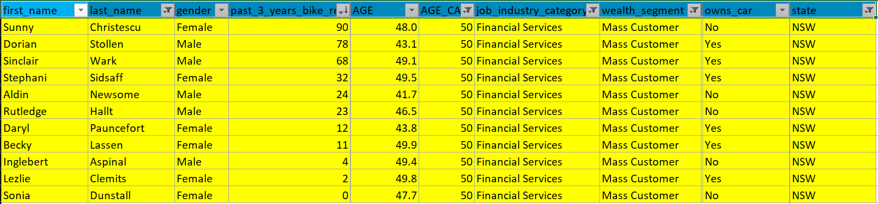
Interpretation
The following are the top level clients to target out of the 1000 new customers list

Slide 11
Appendix

